Slide 1
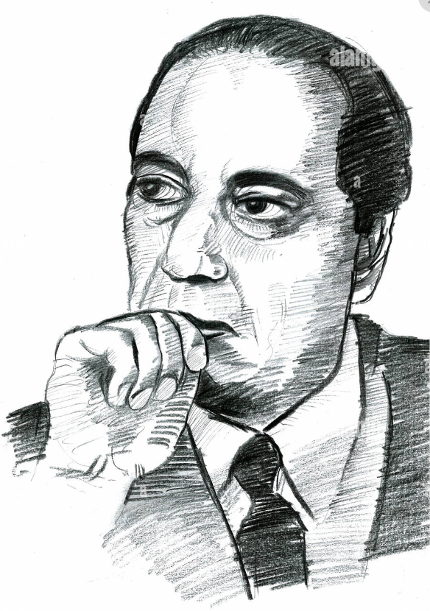
Biography of Dr. Homi J. Bhabha
Assignment in Human Dynamics and Peace in Communication by
109054. Krishnaraj

Slide 2
Lets start with why learn about him in the first place, and lets start from the beginning...

Slide 3

The 3 Turning points in Humanity’s Past..

Slide 4
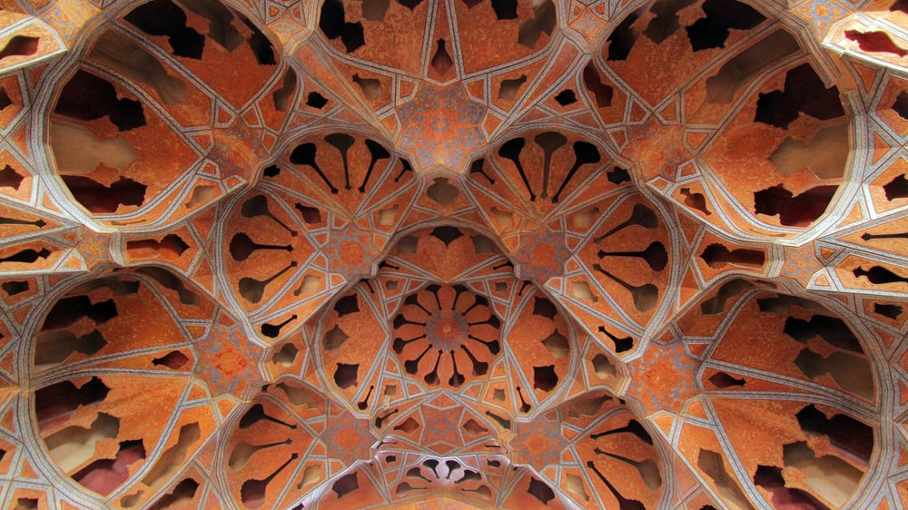
The Beginning of Civilization

Slide 5
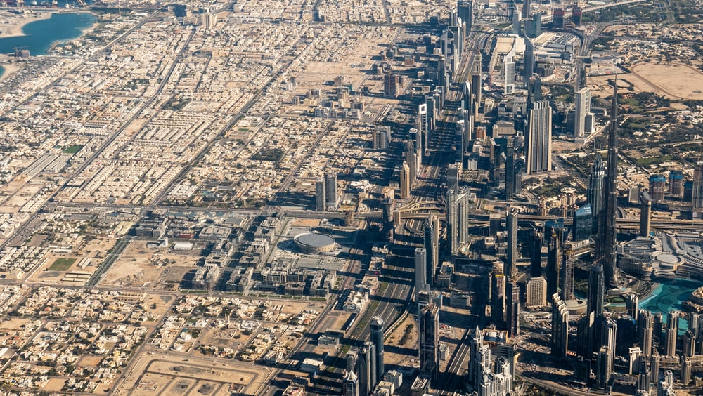
The Industrial Era

Slide 6

The Nuclear Era

Slide 7

Dr. Homi j Bhabha is the Father of the Indian Nuclear Programme
Bhabha was also the founding director of the Atomic Energy Establishment, Trombay (AEET) which is now named the Bhabha Atomic Research Centre in his honour. TIFR and AEET were the cornerstone of Indian development of nuclear weapons which Bhabha also supervised as director.

Slide 8
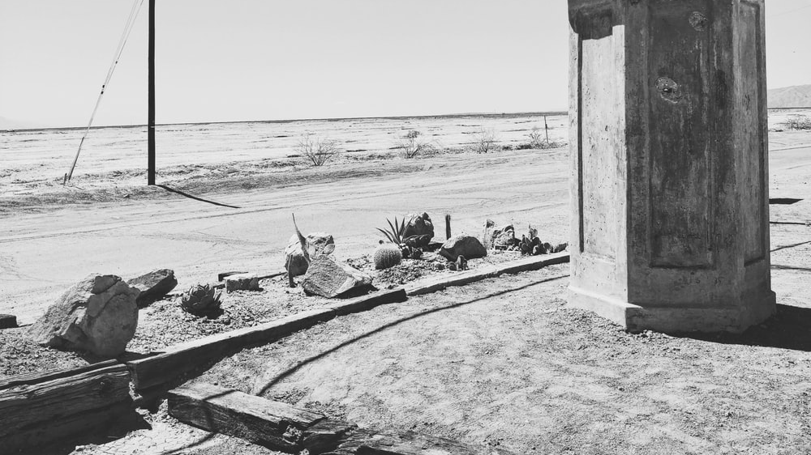
Early Life

Slide 9
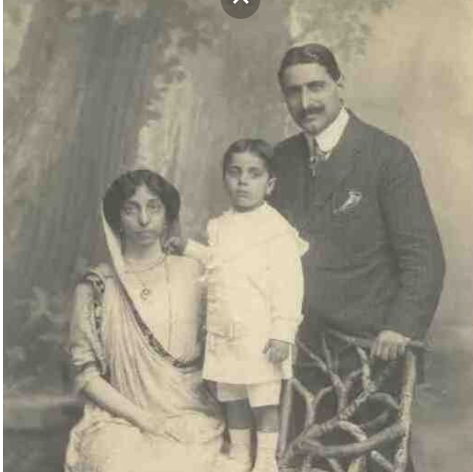
Family Background
Homi Jehangir Bhabha was born in Bombay on October 30, 1909 to Jehangir and Meherbai Bhabha. After marriage, the couple moved to Bombay, the first commercial city of British India where young Bhabha spent his childhood.

Slide 10
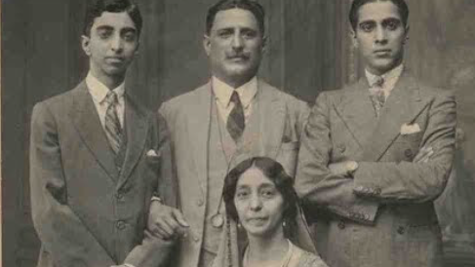
Connection to the Tatas
Homi’s paternal aunt, also Meherbai, was married to Dorab Tata, the elder son of the pioneer of Indian industry, Jamsetji Nusserwanji Tata. Here, at the Tatas’ ancestral home, the commercial world of his industrialist uncle revealed itself to the young Homi. But he also observed the deep bonds that the Tatas had forged with institutions of learning notably the Indian Institute of Science, Bangalore, of which, Sir Dorab had taken charge of, following the death of Jamsetji Tata.

Slide 11
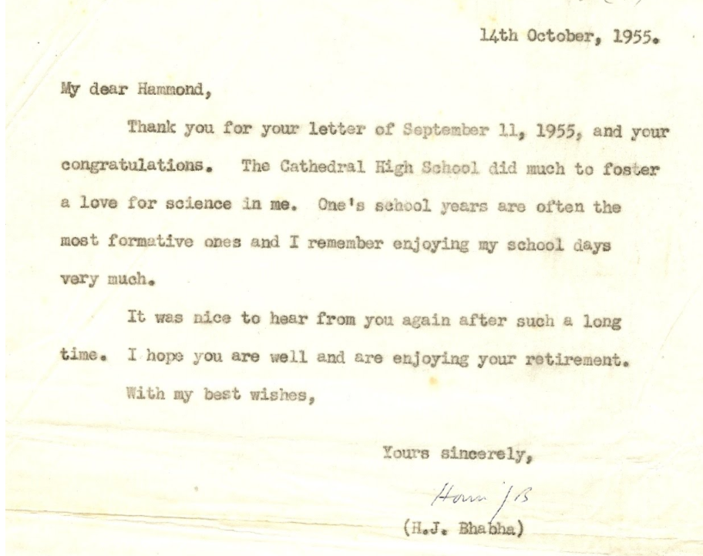
Education
Homi had his schooling at the Cathedral and John Connon School, Bombay, which, he would observe years later, did much to foster his love for science.

Slide 12
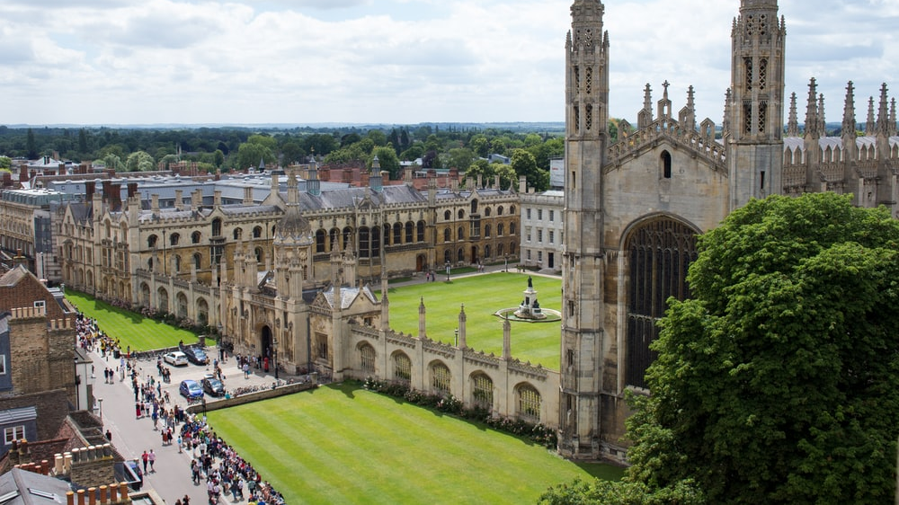
University and Love for Physics
Bhabha enrolled for Mechanical Tripos in Cambridge since his father and his uncle, Sir Dorab wanted him to become an engineer and join the Tata Industries. At Cambridge, Homi’s interests soon shifted to theoretical physics and mathematics. He described this passion in a letter to his father in 1928:

Slide 13
His letter to his Father
“I seriously say to you that business or a job as an engineer is not the thing for me. It is totally foreign to my nature and radically opposed to my temperament and opinions. Physics is my line. I know I shall do great things here. For, each man can do best and excel in only that thing of which he is passionately fond, in which he believes, as I do, that he has the ability to do it, that he is in fact born and destined to do it...Besides India is not a land where science cannot be carried on.”

Slide 14
“I am burning with a desire to do physics. I will and must do it sometime. It is my only ambition. I have no desire to be a ‘successful’ man or the head of a big firm. There are intelligent people who like that and let them do it... It is no use saying to Beethoven, ‘You must be a scientist, for it is a great thing’ when he did not care two hoots for science; or to Socrates, ‘Be an engineer: it is the work of an intelligent man.’ It is not in the nature of things. I therefore earnestly implore you to let me do physics.”

Slide 15
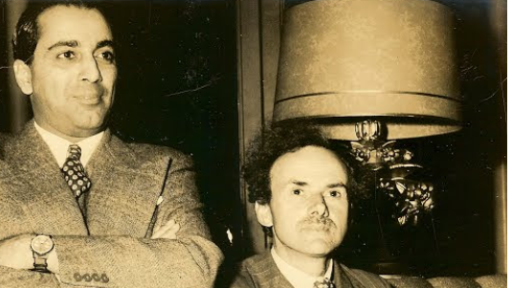
Scientific Discoveries
Bhabha was the first to do a proper quantum theoretic calculation of the process of electron-positron annihilation and creation – one of the basic processes in quantum electro dynamics using Dirac’s theory. This process, known as the Bhabha Scattering, is even today used as a luminosity monitor in electron-positron collider physics experiments.
Jointly with the German scientist W. Heitler, then at Cambridge, Bhabha explained the cosmic-ray shower formation in a paper published in 1937.
It had been discovered by 1918 that there is a strong level of radiation in the upper atmosphere. Robert Millikan, who was the first to identify that the origin of the radiation was from outside the Earth, called it cosmic radiation.

Slide 16
Predicting a new Particle
To explain the penetrating component, Bhabha made the far-reaching hypothesis that there must exist a new particle with the same characteristics as the electron but approximately 100 times heavier. This was an original deduction and Bhabha’s prediction was soon corroborated by the discovery of Neddermeyer and Anderson. These particles were then given the name “meson”. Today this particle is called the ‘muon’. It is approximately 200 times heavier than the electron.

Slide 17
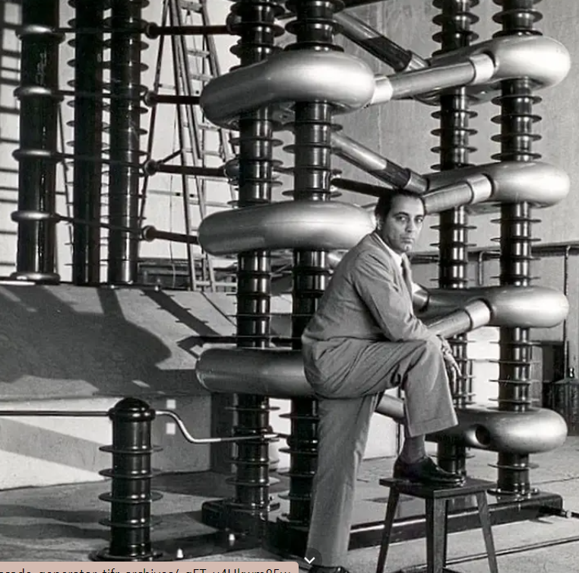

Slide 18
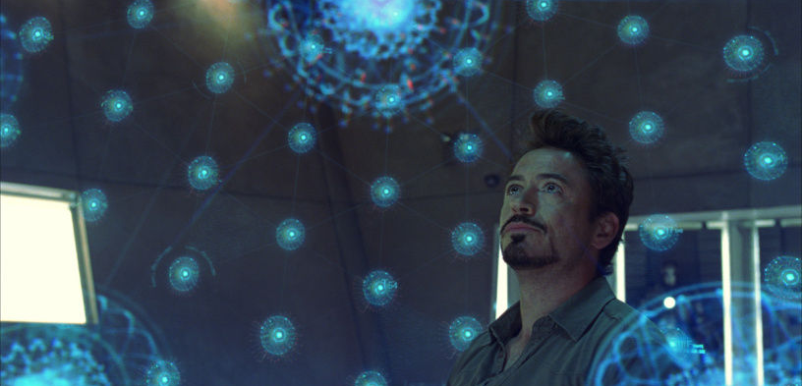
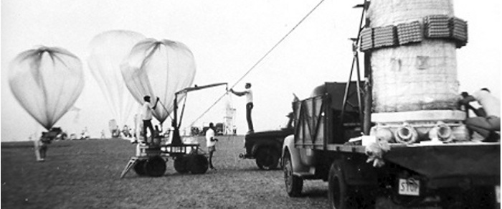
This is how creating something new would actually look like

Slide 19
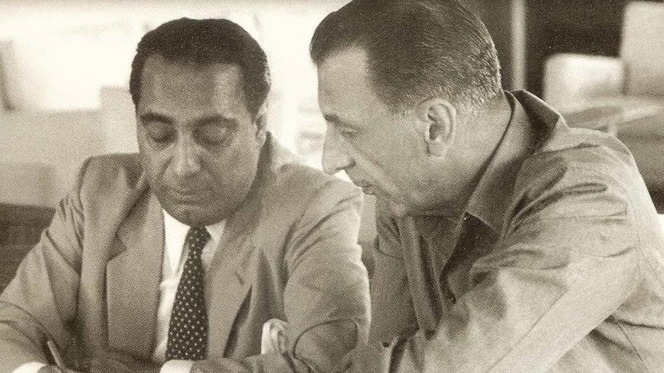
Bhabha was also the first to point out that cosmic rays, moving at speeds close to that of light, are the best place to verify the conclusions of Einstein’s Special Theory of Relativity. For example, mesons, which normally decay within a distance of half a kilometer, can travel more than 10 km down to the Earth’s surface because relativistic time dilation increases their decay lifetime.
Bhabha proposed vector mesons as particles, in addition to Yukawa’s scalar mesons, that would play a role in the nuclear interaction. These vector mesons were massive, had spin one and odd parity. Thus he explained the fact that the triplet state of the deuteron (a heavy isotope of hydrogen whose nucleus has one proton and one neutron) was the lowest stable state.

Slide 20
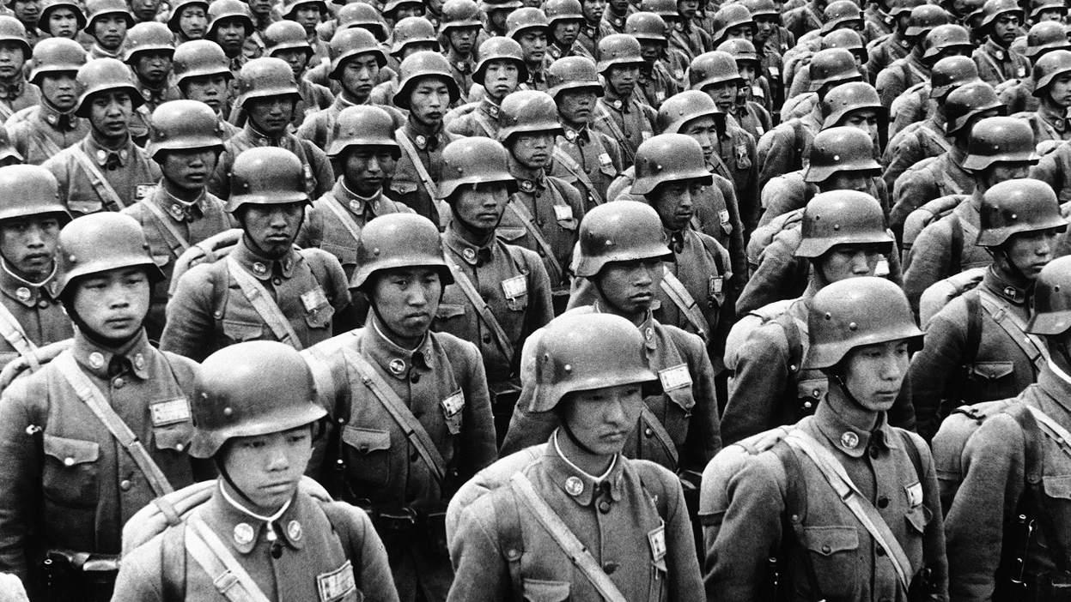
The Turning point in his life, his visit to India in 1939
Bhabha came to India for a holiday in 1939, but the outbreak of the Second World War in September 1939 made him change his plans. He joined the Indian Institute of Science at Bangalore, where a Readership in Theoretical Science was specially created for him. Prof. C.V. Raman, who was at IISc at that time, was highly impressed by Homi Bhabha.

Slide 21
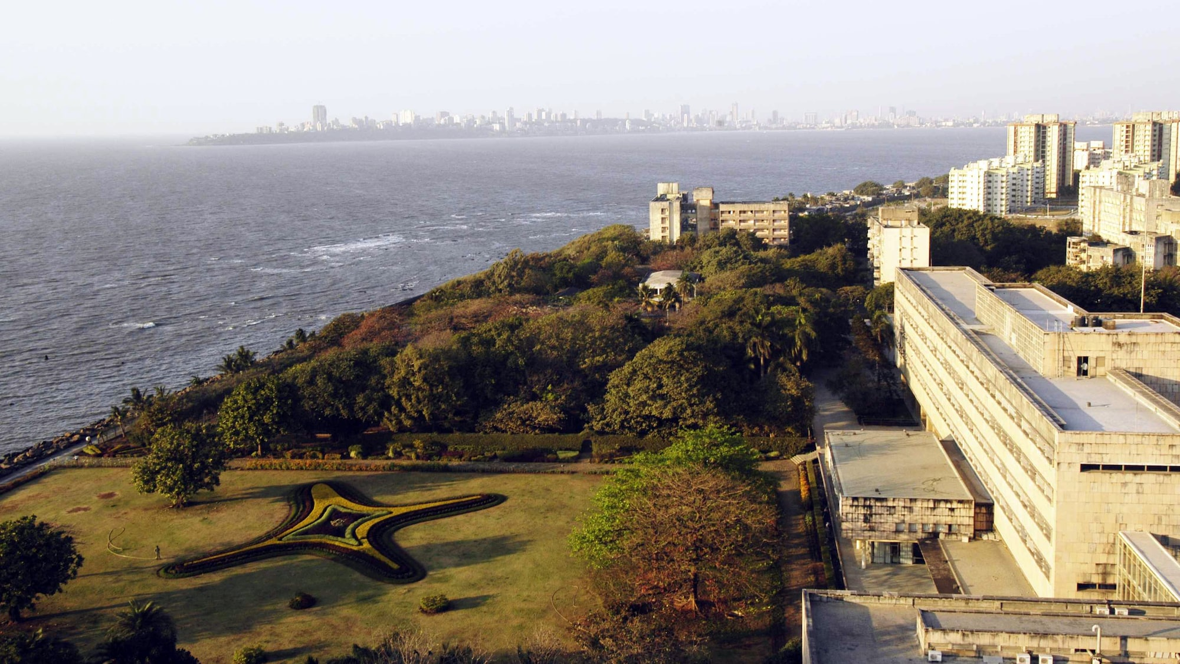
Formation of the TIFR
During his five-year period in Bangalore, Bhabha realized the difficulty of carrying out research activities in India. He understood that none of the existing research institutions in the country had facilities for original work in nuclear physics, cosmic ray physics, high energy physics and other frontiers of physics. In a letter to his friend, J.R.D Tata, Bhabha wrote “The lack of proper conditions and intelligent financial support hampers the development of science in India at the pace the talent in the country would warrant”

Slide 22
The Letter
“ I have for some time past nurtured the idea of founding a first class school of research in the most advanced branches of physics in Bombay...”
“ ....There is at the moment in India no big school of research in the fundamental problems of physics, both theoretical and experimental.... It is absolutely in the interest of India to have a vigorous school of research in fundamental physics, for such a school forms the spearhead of research not only in less advanced branches of physics but also in problems of immediate practical application in industry.”

Slide 23
“ When nuclear energy has been successfully applied for power production in, say, a couple of decades from now , India will not have to look abroad for its experts but will find them ready at hand.”
" The scheme I am now submitting to you is but an embryo from which I hope to build up in the course of time a school of physics comparable with the best anywhere."

Slide 24
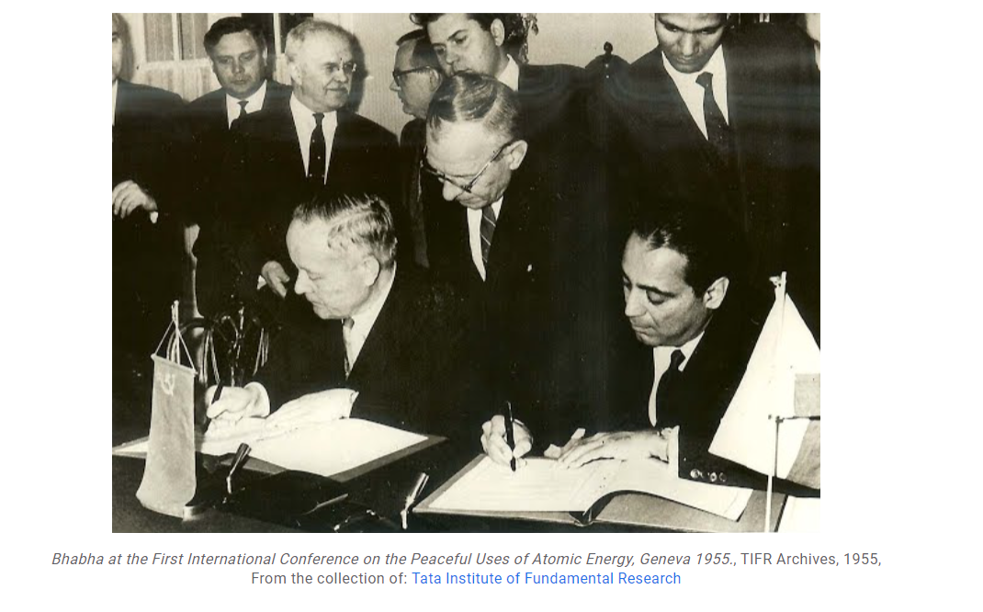
His advocation for Peace of Nuclear Weapons

Slide 25
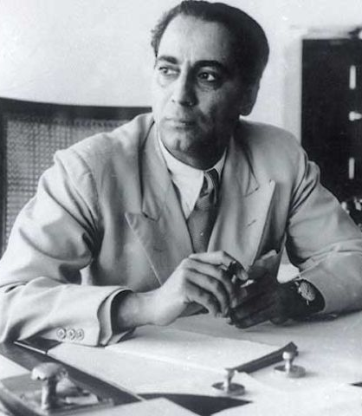
Awards
Fellow of the Royal Society, 1941 Adams Prize, Cambridge, for a thesis on “The theory of the elementary physical particles and their interactions,” 1942 Hopkins Prize of the Cambridge Philosophical Society, 1948 Padma Bhushan, 1954 President, First International Conference on Peaceful Uses of Atomic Energy, held under the auspices of the UN, 1955

Slide 26
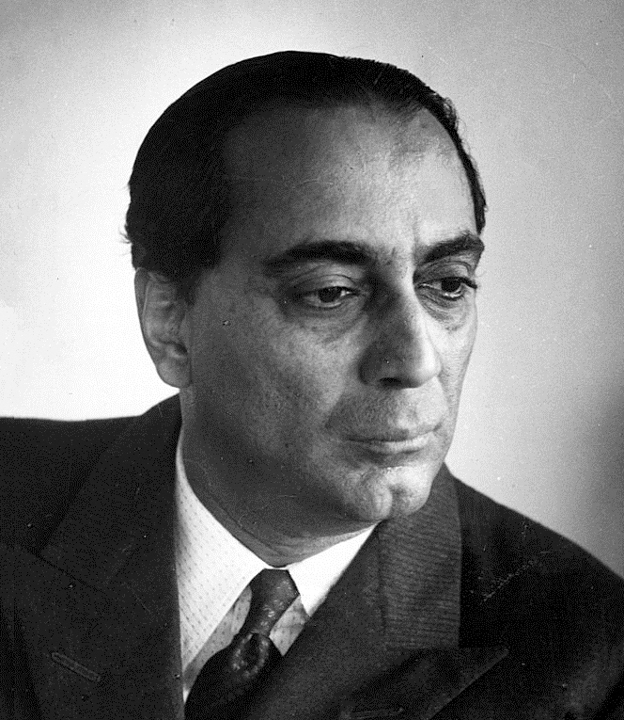
• Honorary fellowship of the Gonville andCaius College (1957), Royal Society of Edinburgh (1957), American Academy of Arts and Sciences (1959), National Academy of Sciences of the UnitedStates (1963) • Honorary Doctoral degrees in science: Patna (1944), Lucknow (1949), Banaras (1950), Agra (1952), Perth (1954), Allahabad (1958), Cambridge (1959), London (1960), Padova (1961) • President, International Union of Pure and Applied Physics, 1960-63 • Melchett Medal of the Fuel Institute, 1964

Slide 27
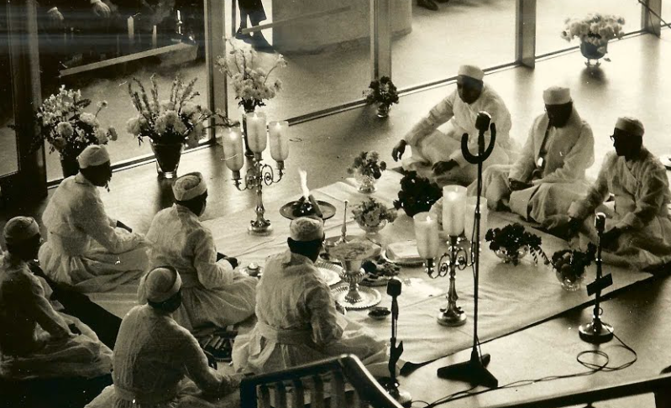
The Plane Crash
“On Monday, 24th January 1966, I was in my office at the Tata Institute of Fundamental Research in Bombay. There was a phone call from Air India to say that their flight that was to land in Geneva had not done so. It was on the aircraft, Kanchenjunga that Homi Bhabha was travelling to Geneva on his way to Vienna. Geneva airport had apparently lost contact with the aircraft. I was told that Air India would keep us in touch with further developments.” – recalls Prof. M.G.K. Menon who took over as Director of TIFR after Homi Bhabha.
Air India’s Boeing 707 crashed on the Mont Blanc in the Alps, killing everyone on board. Homi Bhabha was on his way to Vienna to attend a meeting of the Scientific Advisory Committee of the International Atomic Energy Agency.

Slide 28

What do we learn from him? What is the aim of this presentation?

Slide 29
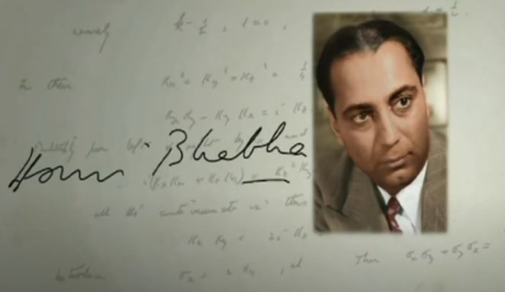
Thank You

